Slide 1


GCSE MATHEMATICS
AIM HIGHER EDITION

Slide 2
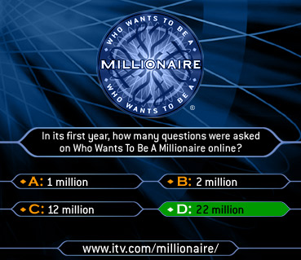
Question 1
Claire has £10 to the nearest pound. What is the maximum amount she could have?
A: £10.49
B: £9.50
C: £10.99
D:£10.49999

Slide 3
Question 2
What is 60 as a product of primes?
A: 2x3x13
B: 2x2x3x5
C: 1x2x5x6
D: 2x2x2x3

Slide 4
Question 3
What is 3.6³ to 3 significant figures?
A: 10.8
B: 46.6
C: 46.656
D: 46.7

Slide 5
Question 4
If a car drives at 30 mph for 2½hours, how far does it travel?
A: 12miles
B: 60.5miles
C: 75miles
D: 22.5miles

Slide 6
Question 5
50 oranges cost £4. How much would it cost for 20 oranges?
00:35
A: £8
B: £1.60
C: 80p
D: 16p

Slide 8
Question 1
Claire has £10 to the nearest pound. What is the maximum amount she could have?
A: £10.49
B: £9.50
C: £10.99
D: £10.49999

Slide 9
Question 2
What is 60 as a product of primes?
A: 2x3x13
B: 2x2x3x5
C: 1x2x5x6
D: 2x2x2x3

Slide 10
Question 3
What is 3.6³ to 3 significant figures?
A: 10.8
B: 46.6
C: 46.656
D: 46.7

Slide 11
Question 4
If a car drives at 30 mph for 2½hours, how far does it travel?
A: 12miles
B: 60.5miles
C: 75miles
D: 22.5miles

Slide 12
Question 5
50 oranges cost £4. How much would it cost for 20 oranges?
00:35
A: £8
B: £1.60
C: 80p
D: 16p

Slide 13
ANSWERS:
A
B
D
C
B

